Slide 1
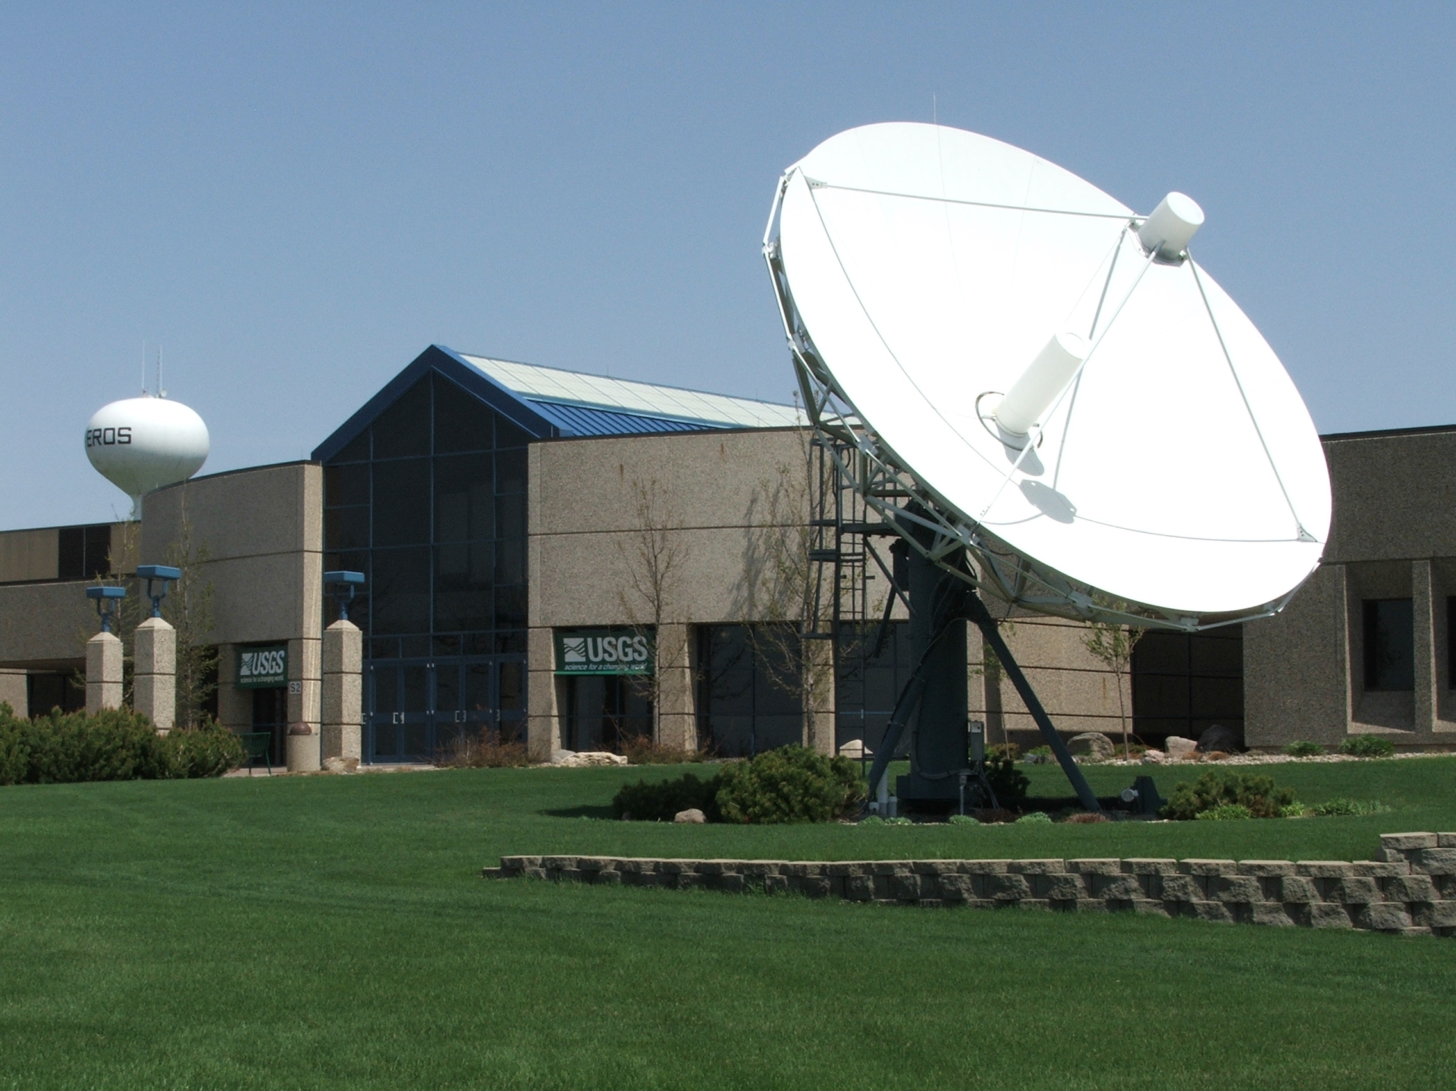
EDDN Status and Information
Dan Schwitalla – ddschwit@usgs.gov
2009 USGS STIWG/TWG – 6-8 May 2014

Slide 2
EDDN Basic Information
EDDN = Emergency Data Distribution Network
Receives data from all DCPs transmitting in the GOES DCS independently of Wallops Island.
It is a satellite downlink at a receive site sufficiently distant from Wallops Island to achieve event independence.
Distributes data independently of Wallops Island.

Slide 3
Recent Updates
The EDDN is now receiving an LRIT data feed. The LRGS connected to the LRIT is internal, but the data is available to the public servers.
The EDDN receive system is now CS2 compliant.

Slide 4
More Information about EDDN at EROS
The EDDN has a public Web page that provides:
Status of the public data servers
Access to a system monitoring page
Web pages that
describe the EDDN,
describe message format of DCP data,
provide message access services,
and make available relevant documentation.
URL is http://eddn.usgs.gov

Slide 5
EDDN Web Services
http://eddn.usgs.gov/msgaccess.html
Users can access GOES DCS messages based upon time, address, and channel criteria. (Does not decode the data)
http://eddn.usgs.gov/fieldtest.html
Provides a low-bandwidth means of publicly accessing messages from a specific DCP. Designed for the access from a cell phone or PDA.

Slide 6
EDDN Message Access

Slide 7
EDDN Field Test Page
Criteria Page
Page Source
<html><head><title>FIELD MESSAGE RETRIEVAL</title><body>
<form action="http://lrgseddn1.cr.usgs.gov/cgi-bin/fieldtest.pl" method="POST">
<p><font size="+1">DCP ADDRESS (required):</font><br>
<input type="text" name="DCPID" size="8"></p>
<p><font size="+1">Back </font><br>
<input type="text" name="SINCE" size="3"> hours</p>
<p><input type="submit" value="Retrieve" name="B1"></p>
</form>
</body></html>
Result Page
EDDN Field Retrieval
DCP: DD29E3F0 From now minus 8 hours until now.
DD29E3F009082065534G42-4NN130WXW000243J@@l@GA@@l@F?@@l@F?zWJ
DD29E3F009082053520G42-4NN130WXW000242E@@l@Fz@@l@Fy@@l@FyzVJ

Slide 8
EDDN National Configuration Repository
A database has been created with web page access that allows users to examine and download configurations used to define sites, sensors, and platforms in the USGS and other government agencies.
The database is updated on Wednesday and Saturday mornings
http://eddn.usgs.gov/configSelect.html

Slide 9
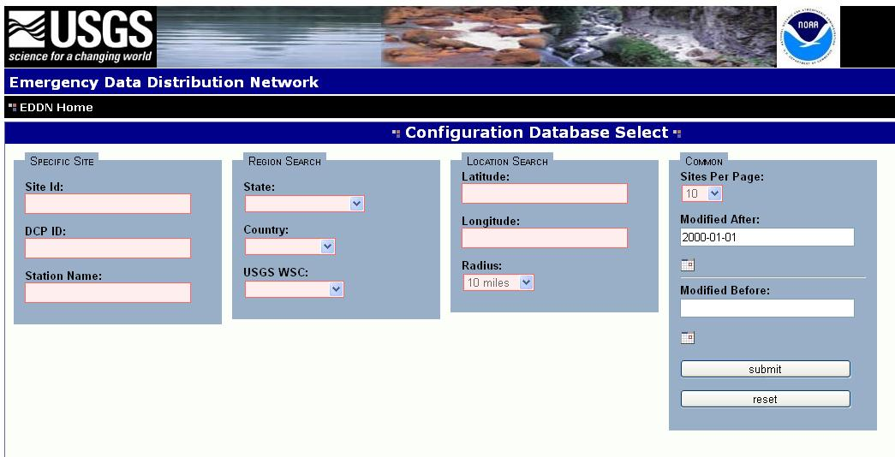
EDDN National Configuration Repository

